Slide 1
TEAM5OIES Online International EVAR System (ANONYMIZED Long Term Follow up EVAR Database) Spring 2015
TEAM5OIES will allow doctors and researchers around the world to share data and analysis about endovascular aneurism repair (EVAR) patients. Specifically the CT scans and the results of simulations ran on the scans to identify indicators of serious long term complications with the newer less invasive method versus the older more invasive method. This will allow doctors to recommend the older method when a patient is at risk for long term complications with the newer method.
Team leader : Obinna Ugwuzor
DBAs: Jessica Balanag Kenny Loveall
SQAs: Eddie Guevara Shah Zaib
TMs: Michelle George Ryan Hornik Joe Lu Hector Reyna

Slide 2
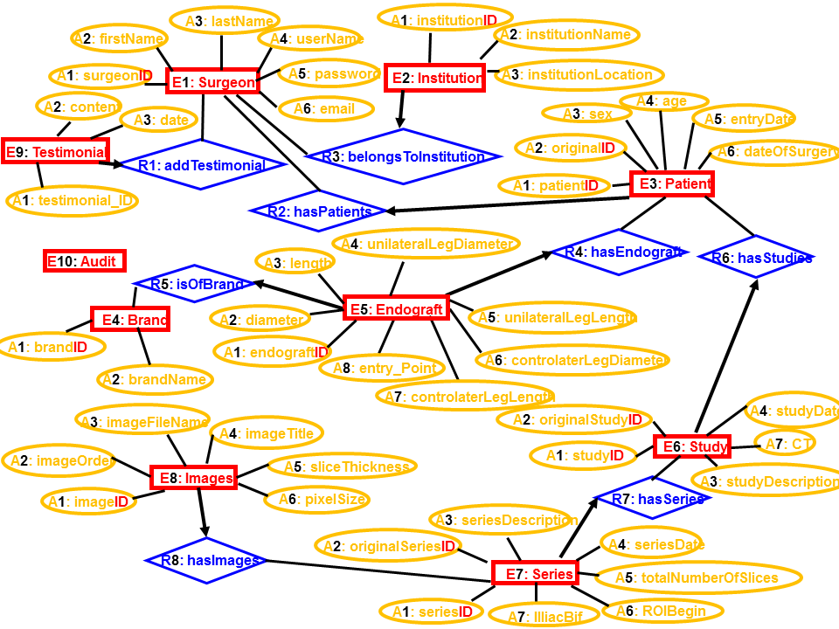
TEAM5OIES Online International EVAR System (ANONYMIZED Long Term Follow up EVAR Database) Data Design – Relational Model
Surgeon
Institution
Patient
Testimonial
Audit
Endograft
Study
Brand
Image
Series

Slide 3
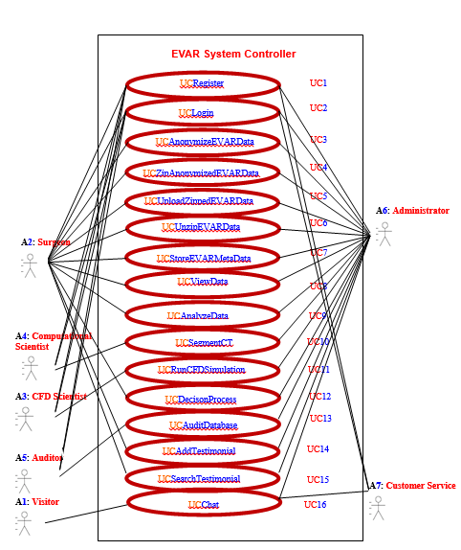
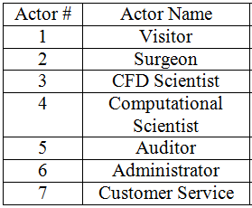
TEAM5OIES Online International EVAR System (ANONYMIZED Long Term Follow up EVAR Database) Business Modeling: UML USE CASE Model

Slide 4
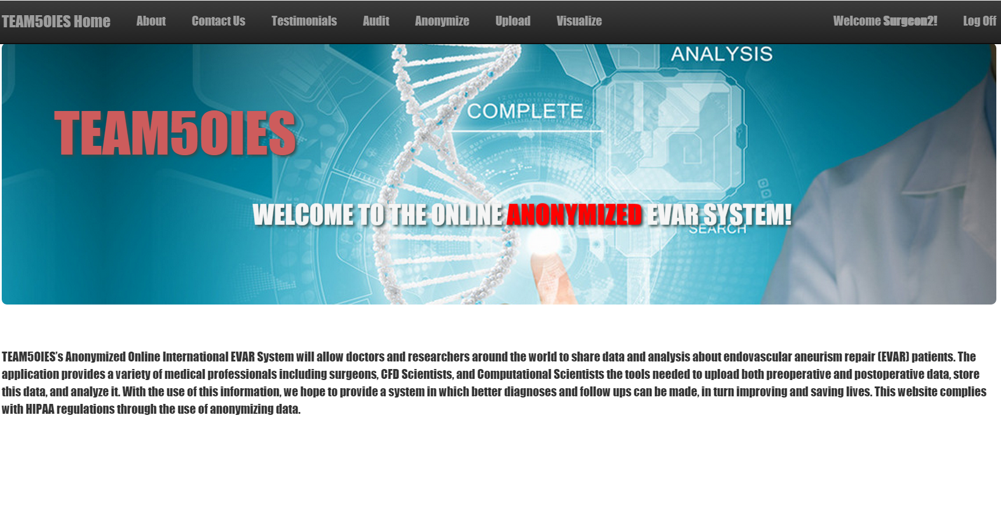
TEAM5OIES Online International EVAR System (ANONYMIZED Long Term Follow up EVAR Database) Website

Slide 5
TEAM5OIES Online International EVAR System (ANONYMIZED Long Term Follow up EVAR Database) Software Project Management Plan
Estimated LOC: 1500 April 1 – 29 UC’s split amongst members of team
Estimated Cost: $256,252
Actual LOC: 4,523 (estimate under by 3,023 LOC)
Actual Cost: $ 772,685 (estimate under by $ 516,433)

Slide 6
TEAM5OIES Online International EVAR System (ANONYMIZED Long Term Follow up EVAR Database) Code Reuse Metrics
Libraries/plugins used: EvilDicom, IonicZip, dclunie.com Dicom Anonymizer, Entity Framework & MicroDicom Approximate LoC written to use these Libraries: ~30
Approximate LoC saved by using Libraries: ~300,000

Slide 7
TEAM5OIES Online International EVAR System (ANONYMIZED Long Term Follow up EVAR Database) Challenges & Lessons Learned
Begin coding early to be able to identify programmatic challenges that may not be immediately apparent based on plan
Check in early & often with team members to find out the status of assignments and reassign things as necessary
Adapt assignments and responsibilities to events occurring in member’s lives
Play to members strengths and assign responsibilities accordingly
Use of the MVC OO Framework allowed us to obtain High cohesion and low coupling in our codebase

